Slide 1

Sprint 2 Demo
Gabrielle Stoney, JAson Hansen, Harrison Dinius, GArdar Benediktsson, Elizabeth Jackson

Slide 2
Sprint 1 - Background
Created a non-interactive UI (views and buttons for each system function)
Research and brainstorming for the algorithm
Solution found for requesting user permissions
V1 of the SRS and SDS were submitted for feedback

Slide 3
Jason Hansen
Debugging and Testing
Helped with algorithm issues
Prepared to plot out test values
Ran into issue with file paths for prototype csv reading
Work on SRS
Event table

Slide 4
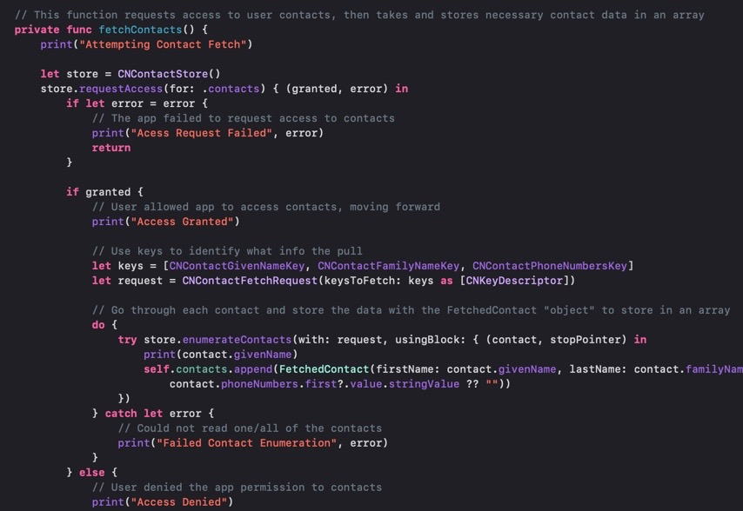
Harrison Dinius
Pulling user contacts and displaying them
Requests permission from user to access contacts
Use Cocoa keys to identify contact data
Data stored in the "FetchedContact" object
Create a new cell for each contact and add info to respective labels
Helped Gardar with integration
Work on SRS
Revisions according to feedback
Applicable standards added

Slide 5
Garðar Benediktsson
Main focus on the Xcode UI
Create ViewControllers to handle the app navigation
Add functionality to the buttons added in Sprint 1
Display values from an "algorithm"
Integrate other team member's code into the main project
Helped with algorithm ideas
For example – add time as weight

Slide 6
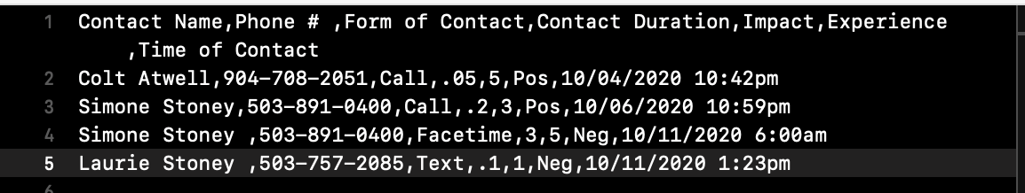
Gabrielle Stoney

Slide 7
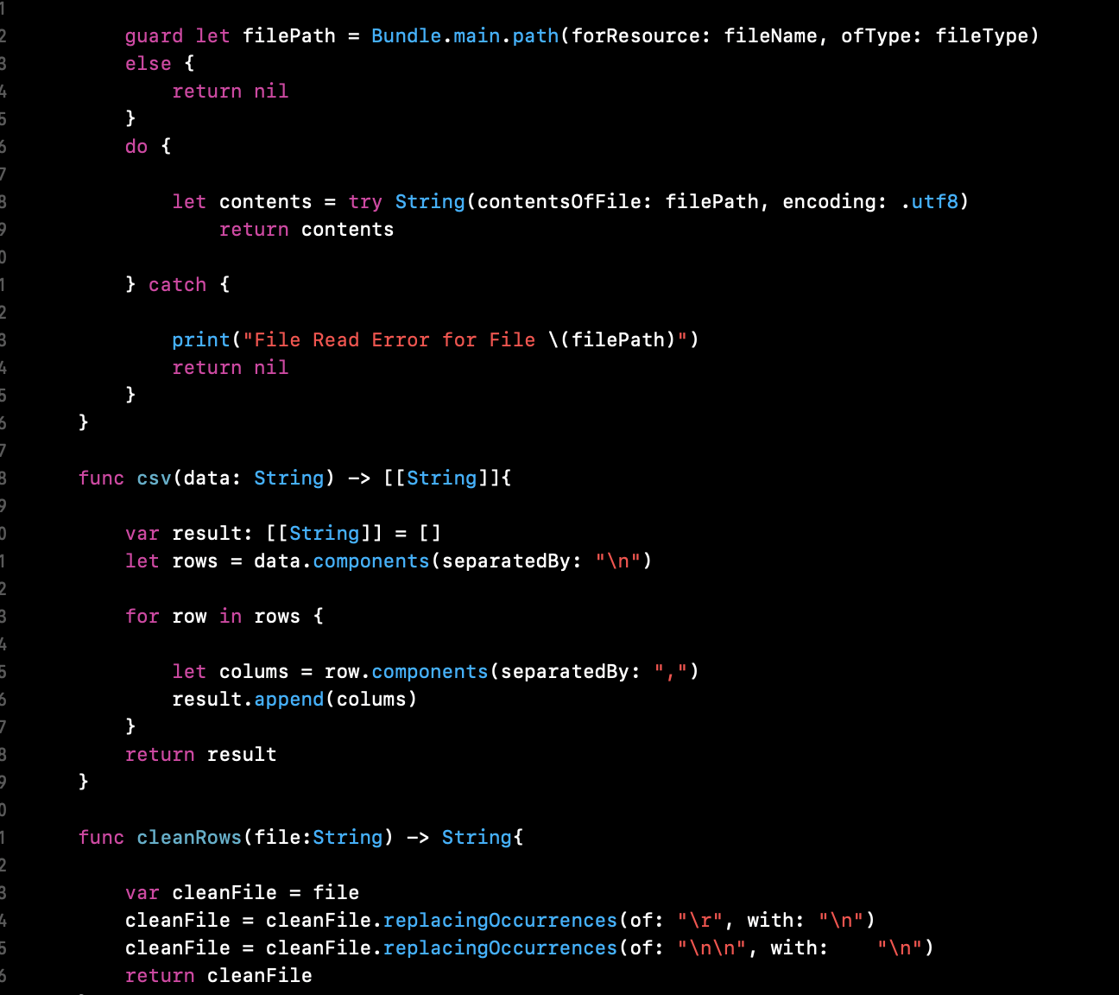
Gabrielle Stoney

Slide 8
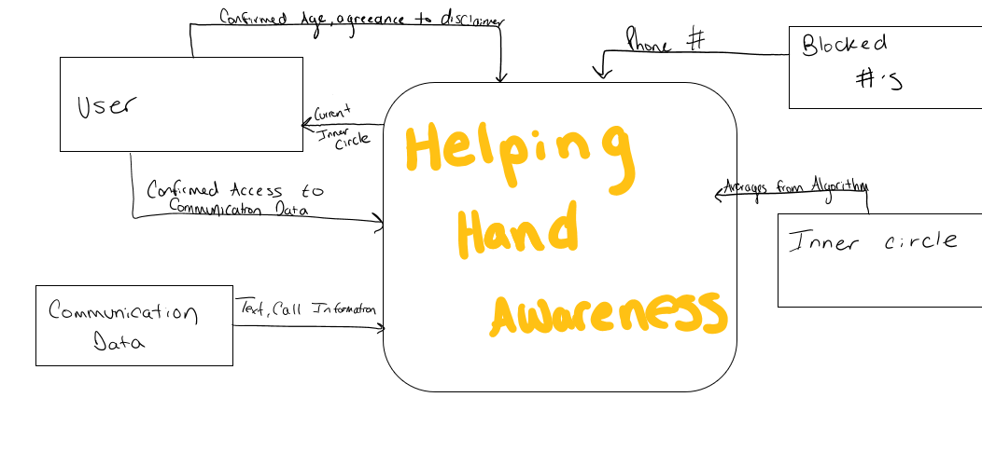
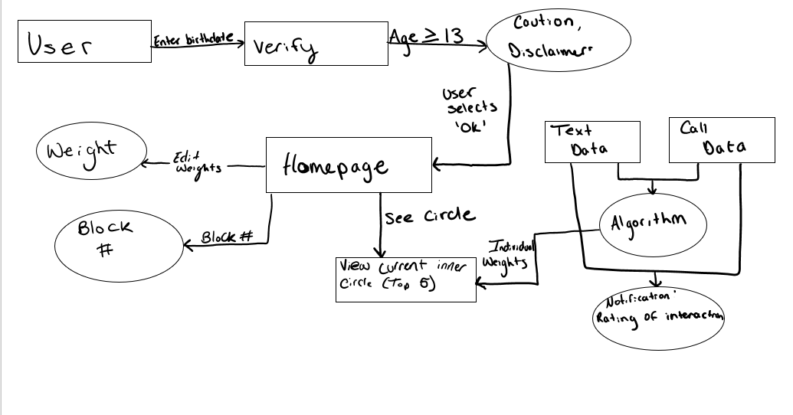
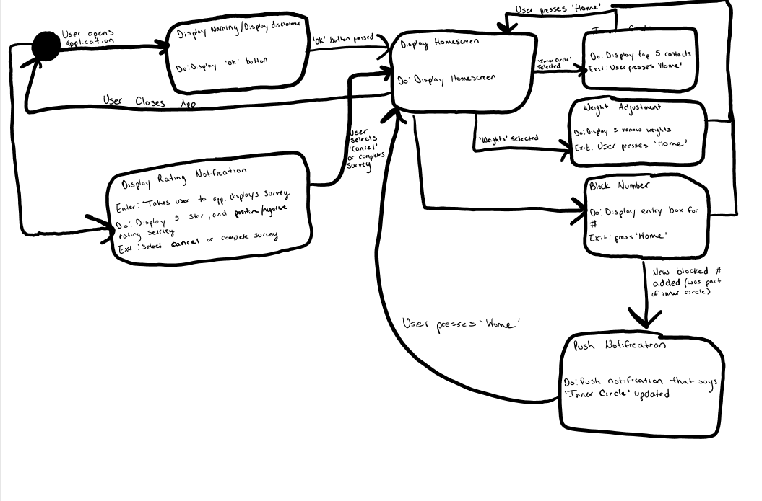
Elizabeth Jackson
Level 0
Level 1
- Created Software Design diagrams Data Flow, Scenarios, and Statechart
- Removed scenarios (did not fit well with our project)
- Worked on SRS and SDD
Statechart

Slide 9
Sprint 2 Demo
https://www.youtube.com/watch?v=W3DpI3gsV3Q

Slide 10
Sprint 3 - Goals
Integrate Gaby's part into the main project
Connect a database
Change the weights through the app
Pull communication info from the phone and put into the algorithm
Block a number

